Slide 1

Insight report on Newman University’s position in the Complete University Guide and the metrics involved.
Review of Newman University’s position in terms of ranking to understand the individual metrics used in the Complete University Guide (CUG) in order to increase our position in the table

Slide 2

Review of Newman University’s position
Presentation made by Aduragbemi Ayeni on 6th of June 2023

Slide 3
SMART Objective
By the end of the academic year 2023/2024, we will increase our position in the Complete University Guide (CUG) league table by analysing our current ranking and understanding the individual metrics used in the CUG and implementing targeted strategies to improve our performance in these metrics.

Slide 4
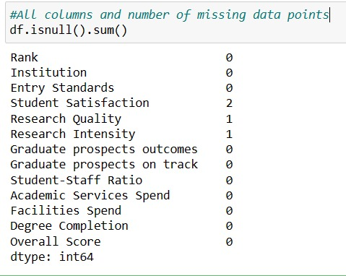
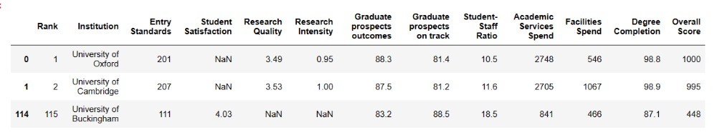
Data Cleaning and Data Preparation (Using Python)
Observation - It was observed that University of Oxford and University of Cambridge had missing cell value under Student Satisfaction. -University of Buckingham had missing cell value under Research Quality and Research Intensity . Action The mean of the two closest non-empty cells was used to replace the missing values for the sake of this project.

Slide 5
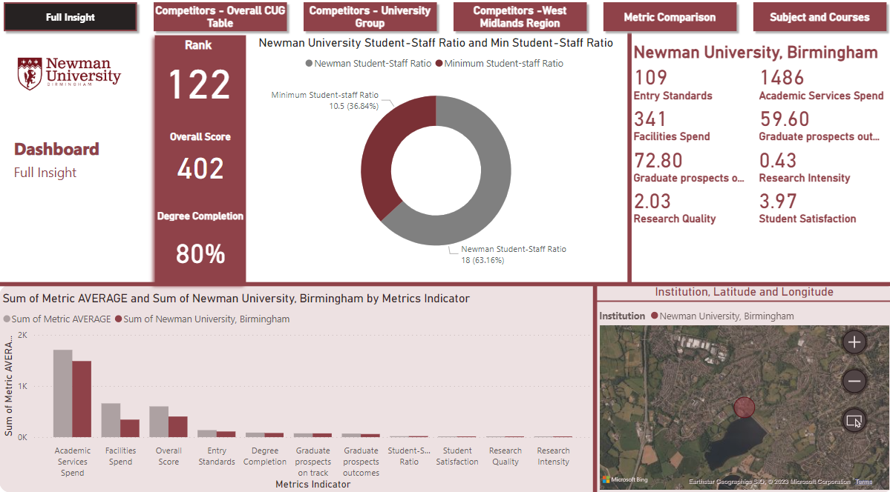
Data Insight
130
1000
100%

Slide 6
Who are our Competitors?
To analyse the competitors, we’ll consider some factors to identify competitors with respect to the Metrics - 5 Top Institutions and 5 bottom Institutions from Newman University position on the League table - West Midlands Region – Newman University falls in west midlands university region in the UK. - Cathedral University Group – Newman university belongs to the cathedral university group in the UK.

Slide 7
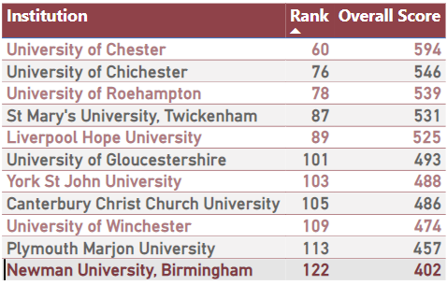
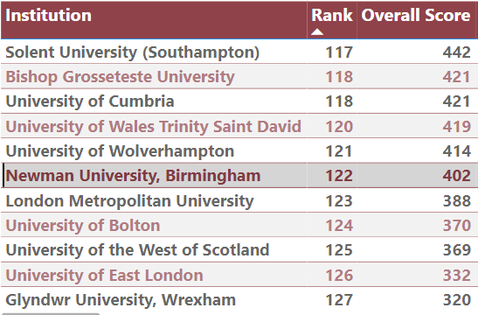
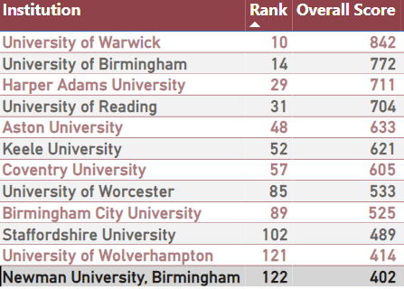
Cathedral University Group
Competitors
5 Top Institution and 5 bottom
West Midland Region
Competitors
Competitors

Slide 8
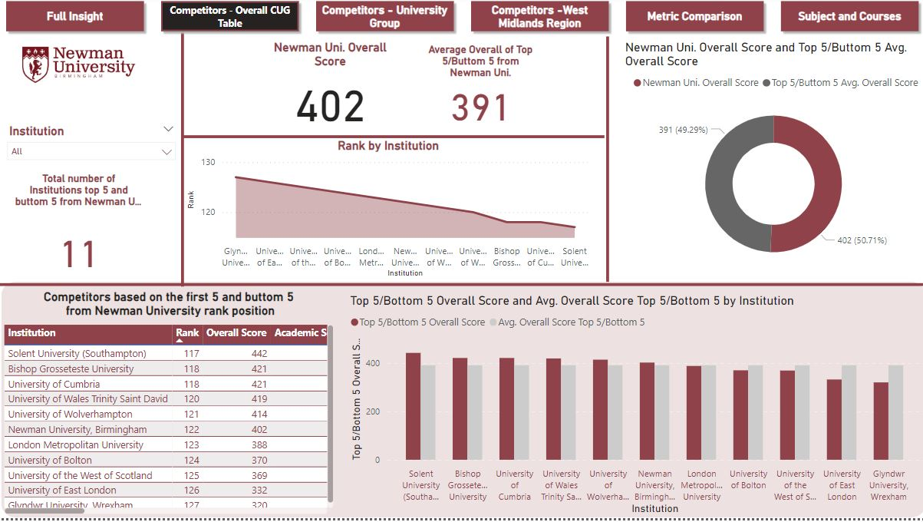
DASHBOARD – Competitors 5 top/5 bottom

Slide 9
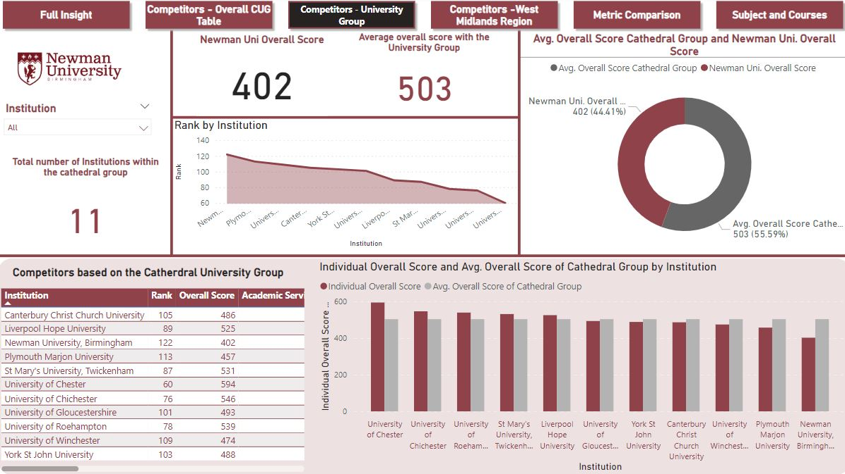
DASHBOARD – Cathedral University Group

Slide 10
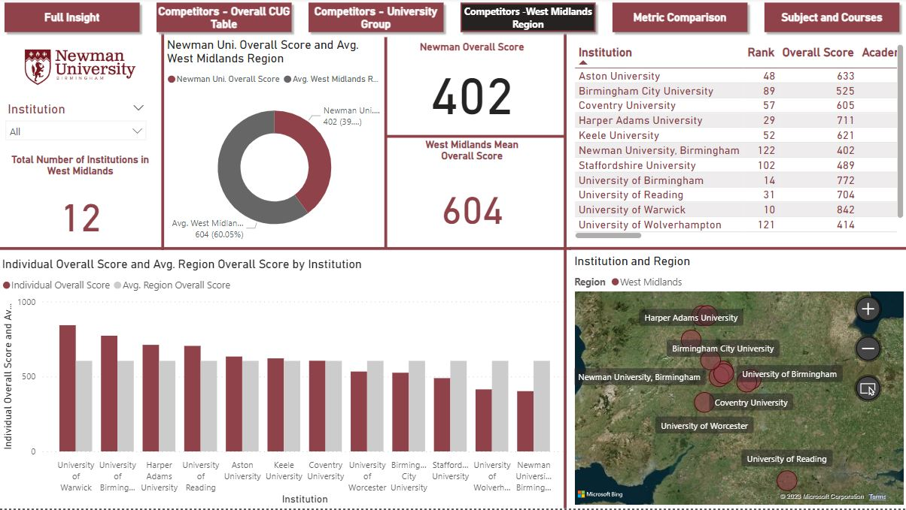
DASHBOARD – Competitors West Midlands Region

Slide 11
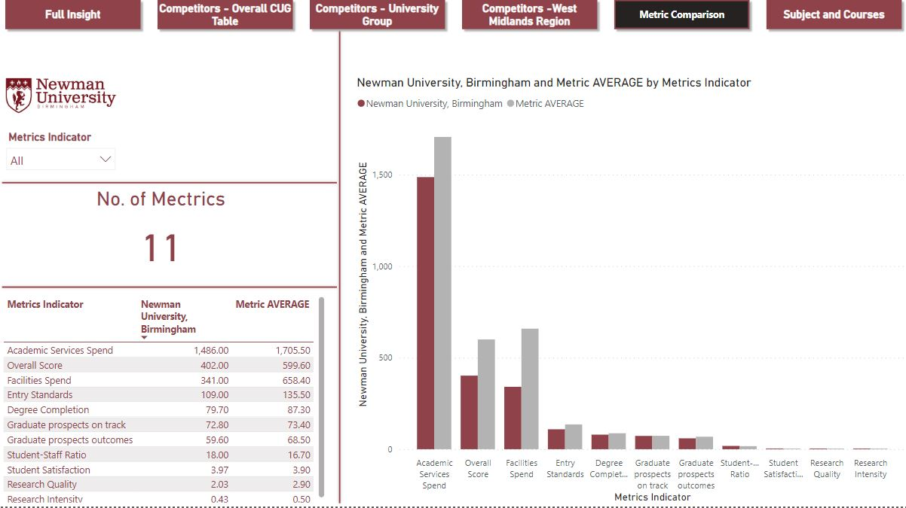
DASHBOARD – Metric Comparison

Slide 12
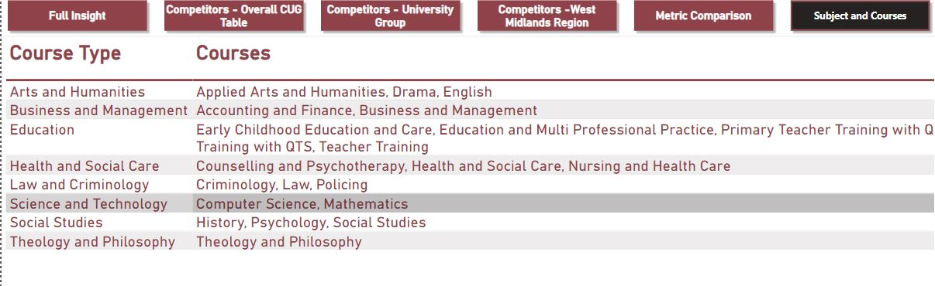
DASHBOARD – Courses and Subjects

Slide 13
What metrics does Newman do well in and what metrics not so well in?
According to the analysis using the mean of other Institutions metrics comparing to Newman’s metrics score It was observed that Newman University performed so well in Student satisfaction – 3.97 out of 3.90 (Average of other Institution)| Max 5 Degree Completion – 79.70 out of 87.30(Average of other Institution)| Max 100 Graduate Prospects on track -72.8 out 0f 73.40(Average of other Institution)| Max 100 However, Newman University did not perform as well in Facilities spend Student-staff ratio metrics Research quality Graduate Prospects on outcomes.

Slide 14
What unique feature is included in the CUG league table as asked in the Graduate Outcomes survey?
The Complete University Guide (CUG) league table includes a unique feature that uses data from the Graduate Outcomes survey. This survey takes place fifteen months after the graduation of students and assesses the extent to which students have taken a positive first step in the 15 months after graduation.

Slide 15
Conclusion
To further analyse university performance, we can consider measures such as Student engagement Diversity and inclusion Social mobility Community engagement and impact Internationalization Sustainability. Data can be sourced from surveys and reports published by universities or independent organizations such as HESA(Higher Education Statistics Agency). HESA publishes data on all aspects of the UK higher education sector. For a tailored dataset, we can contact HESA's expert data analysts or submit their data request form to finalize our data requirements.

Slide 16
Recommendation
Here are some actionable ideas that Newman University could employ to improve position on the university league table by the end of the academic year 2023/2024
1. Improve research quality and intensity: Newman University can invest in research by providing funding and resources to support research projects and collaborations. We could also recruit and retain high-quality research staff and provide opportunities for professional development.
2. Enhance graduate prospects: Newman University could work on improving the employability of their graduates by providing career services, internships, and networking opportunities. We could also develop partnerships with employers to create job opportunities for their graduates.
3. Reduce student-staff ratio: Newman University can hire more academic staff to reduce the student-staff ratio. This would improve the quality of education by allowing for more individual attention and support for students.
4. Increase spending on academic services and student facilities: Newman University can invest in improving academic services and student facilities by upgrading infrastructure, technology, and equipment. This would enhance the learning experience for students and improve their satisfaction.

Slide 17
Thank you

